Slide 1
Full Stack Development

Slide 2
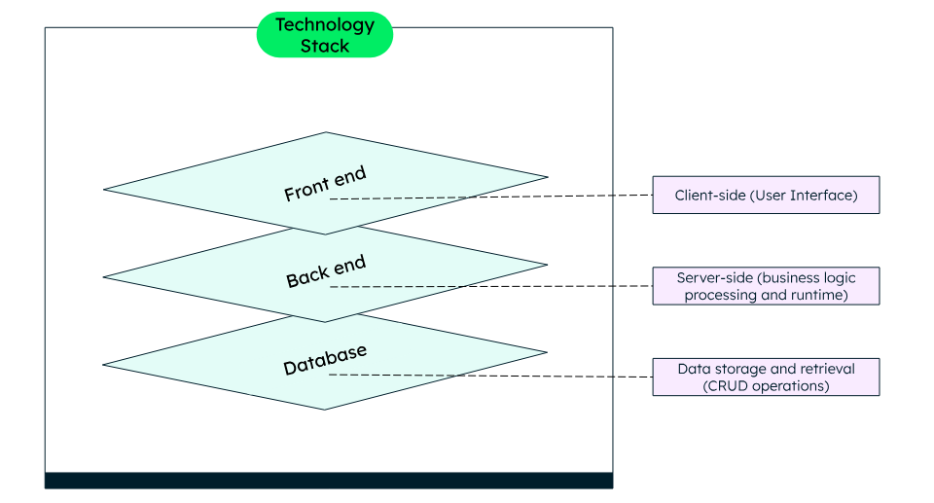
Technology Stack

Slide 3
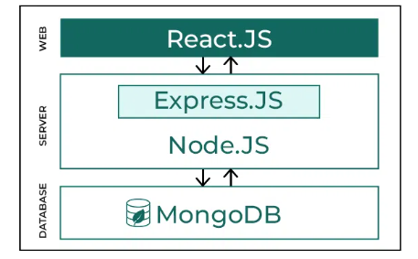
How MERN Stack Works

Slide 4
MERN
MongoDB — document database
Express(.js) — Node.js web framework
React(.js) — a client-side JavaScript framework
Node(.js) — the premier JavaScript web server (runtime)
*The primary programming language for the MERN stack is JavaScript

Slide 5
Introduction to NodeJS

Slide 6
What is Node JS
Node.js is an open-source, cross-platform JavaScript runtime environment that allows developers to run web applications outside of a browser
Node.js allows developers to use JavaScript for server-side scripting and command line tools. It's often used to generate dynamic web page content before sending it to the user's browser
Node.js runs on the V8 JavaScript engine, which is the core of Google Chrome. It uses an event-driven, asynchronous model that allows it to handle thousands of concurrent connections with a single server
As an asynchronous event-driven JavaScript runtime, Node.js is designed to build scalable network applications.
Ryan Dahl developed Node.js in 2009. The latest version of Node.js is 23.5.0, which was released on December 19, 2024.

Slide 7
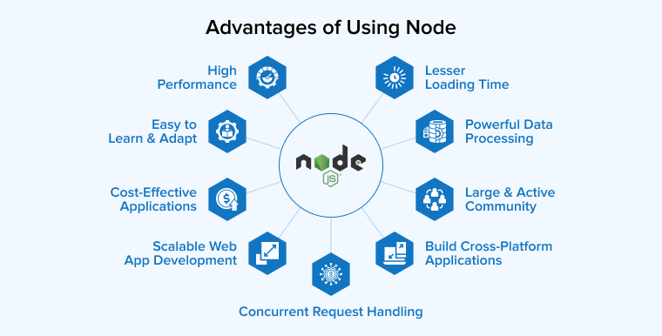

Slide 8
Traditional Web Server Model
The traditional web server model is a synchronous, or blocking, model that uses a pool of threads to process requests
Request processing: When a request comes in, it's assigned to a thread in the pool. The thread executes the request and doesn't return to the pool until it's complete.
Waiting for a thread: If there's no available thread, the request waits until a previous request finishes and the thread is returned to the pool.
Client-server model: The web server process is an example of the client-server model, where a client requests information from a server, which then provides the requested information.

Slide 9
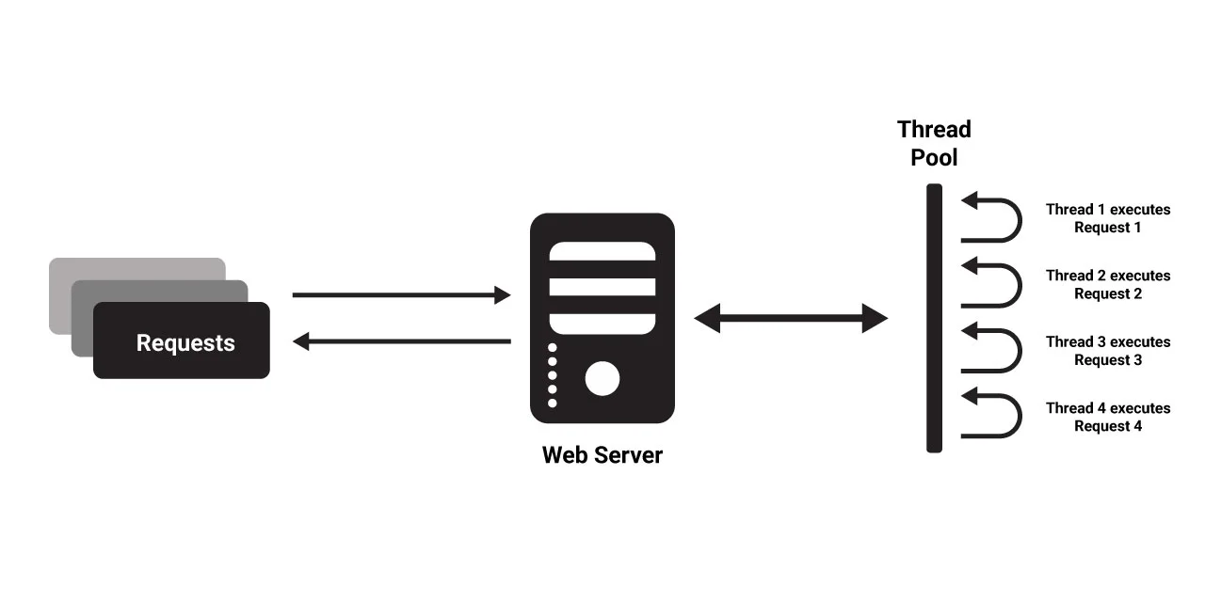
Traditional Web Server Model

Slide 10
How Node.JS Works?
Node.js accepts the request from the clients and sends the response, while working with the request node.js handles them with a single thread.
To operate I/O operations or requests node.js use the concept of threads.
Thread is a sequence of instructions that the server needs to perform.
It runs parallel on the server to provide the information to multiple clients.
Node.js is an event loop single-threaded language.
It can handle concurrent requests with a single thread without blocking it for one request.

Slide 11
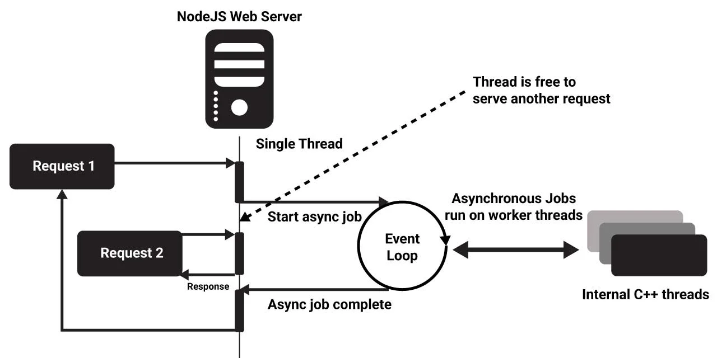
Node.js Process Model

Slide 12
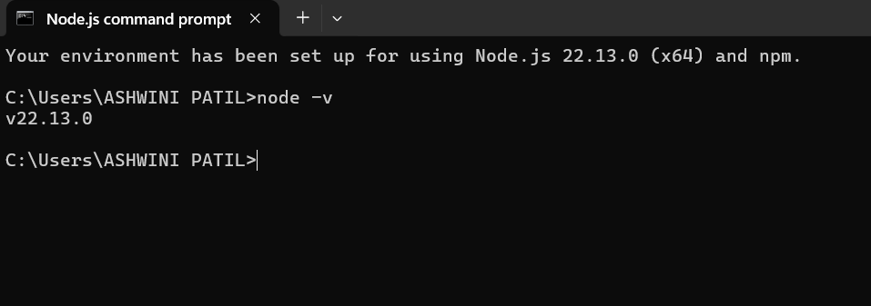
Install Node.js on Windows
Visit Node.js official web site https://nodejs.org. It will automatically detect OS and display download link as per your Operating System.
Once you install Node.js on your computer, you can verify it by opening the command prompt and typing node -v. If Node.js is installed successfully then it will display the version of the Node.js installed on your machine

Slide 13
Working in REPL/Node.js Console
REPL stands for Read-Eval-Print Loop

Slide 14
JavaScript
Data Types- Dynamic and Weak Typing
Classes
Variables
Functions
this operator
Loops
Arrays

